Slide 1
Multiperspective Perceptron Predictor
Daniel A. Jiménez
Department of Computer Science & Engineering
Texas A&M University
and
Barcelona Supercomputing Center

Slide 2
Evolution of perceptron branch prediction
We introduced the perceptron branch predictor [Jiménez & Lin 2001]
Key improvements since then:
Path-based history overcomes linear separability and latency problems, improves accuracy at the cost of more tables [Jiménez 2003,2005]
Hashing histories uses fewer tables [Tarjan & Skadron 2004, Seznec 2005, Loh & Jiménez, 2005]
TAGE-SC-L [Seznec 2014] uses perceptron predictor as a component (SC)
Multiperspective [Jiménez 2016], many features optimized by genetic algorithm
Perceptron branch predictor used in processors you can buy today
All recent AMD processors
IBM z14/z15
Oracle SPARC T4
I designed neural predictor in Samsung Exynos SoC in Galaxy S7, S8, S9, S10, S20
Etc.

Slide 3
My entry for CBP 2025
Based on Multiperspective Perceptron Predictor (MPP)
Combined with the 64KB TAGE-SC-L provided by organizers
Applies some optimizations:
MPP optimized to complement TAGE-SC-L
Non-linear transfer functions for MPP and SC
MPP and SC outputs combined, specialized for MPP & TAGE predictions and TAGE confidence
Bloom filters for always/never taken branches (because BTB is missing)
Speculative table updates using prediction not ground truth, rolled back on misprediction

Slide 4
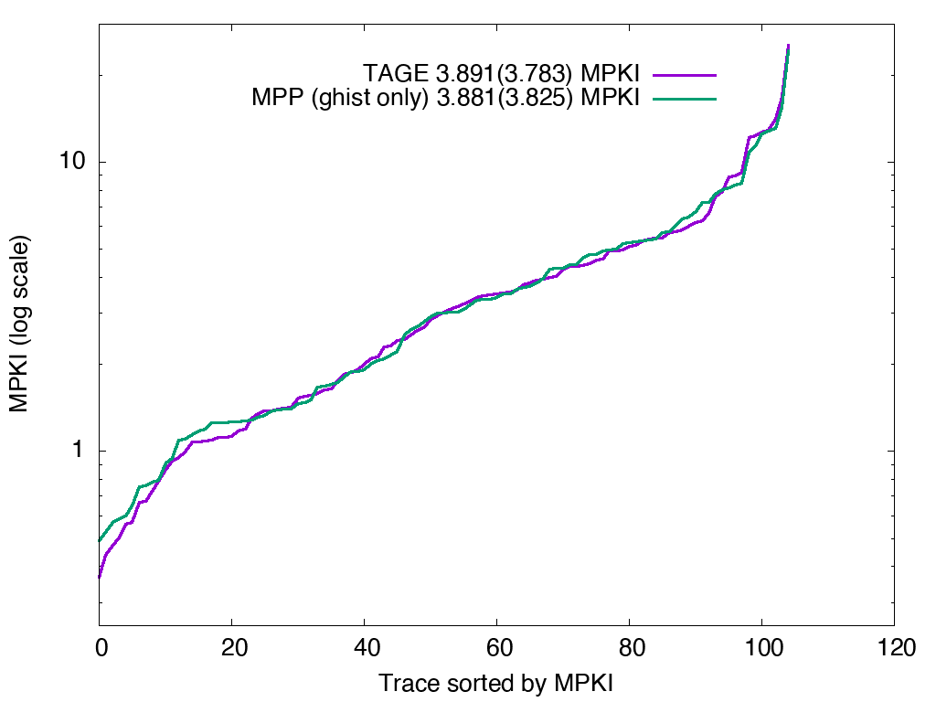
TAGE is limited
Uses only global history
Must use history lengths with total ordering in order to choose the longest match
About the same as perceptron with global history intervals at 192KB
All predictors 192KB, unweighted (weighted) MPKIs

Slide 5
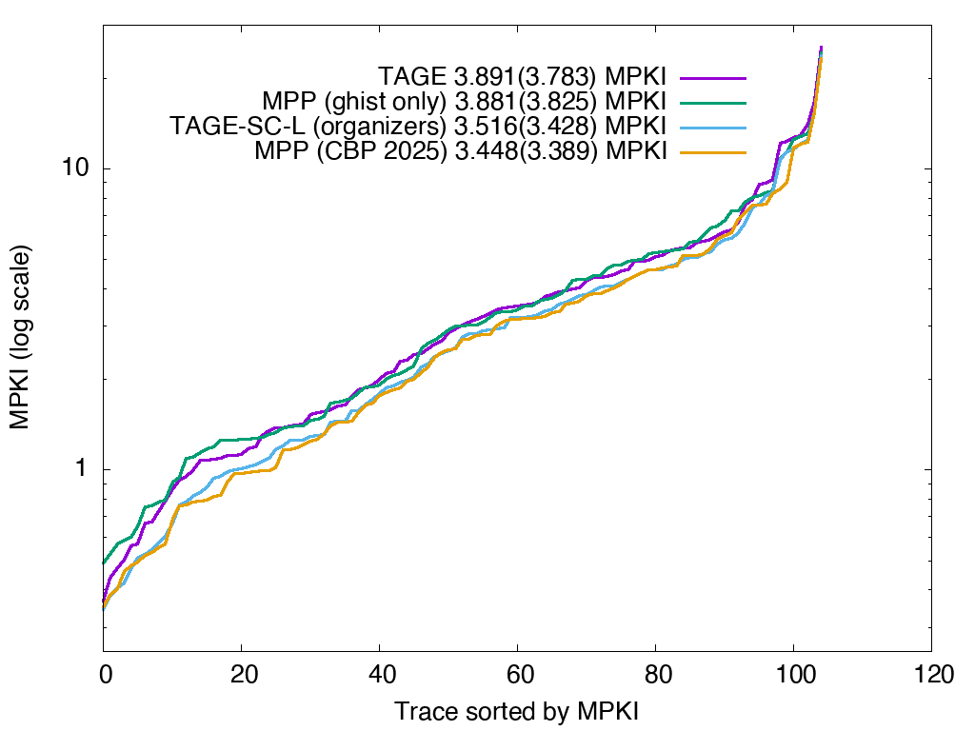
Perceptron is essential to accuracy
Perceptron can use multiple kinds of history beyond ghist (e.g. local, intervals, etc. see following slides)
TAGE-SC-L combines TAGE with perceptron using multiple kinds of history
Don’t build a processor today with TAGE only – poor accuracy
All predictors 192KB, unweighted (weighted) MPKIs

Slide 6
Multiperspective idea
Rather than just global/local history, use many features
Multiple perspectives on branch history
Multiperspective Perceptron Predictor
Hashed Perceptron
Sum weights indexed by hashes of features
Update weights using perceptron training
Contribution is a wide range of features

Slide 7
Traditional features
GHIST(a,b) – hash of a to b most recent branch outcomes
PATH(a,b) – hash of recent a PCs, shifted by b
LOCAL – “per-branch” histories (PC hashed into fixed-sized table)
GHISTPATH - combination of GHIST and PATH
BIAS – bias of the branch to be taken regardless of history

Slide 8
Novel features
IMLI – from André’s innermost loop iteration counter:
When a backward branch is taken, count up
When a backward branch is not taken, reset counter
I propose an alternate IMLI
When a forward branch is not taken, count up
When a forward branch is taken, reset counter
This represents loops where the decision to continue is at the top
Typical in code compiled for size or by JIT compilers
Works better than backward IMLI on recent workloads
I tried both forward and backward in the predictor

Slide 9
Novel features cont.
MODHIST – modulo history
Branch histories become misaligned when some branches are skipped
MODHIST records only branches where PC ≡ 0 (mod n) for some n.
Hopefully branches responsible for misalignment will not be recorded
Try many values of n to come up with a good MODHIST feature

Slide 10
Novel Features cont.
MODPATH – same idea with path of branch PCs
GHISTMODPATH – combine two previous ideas
RECENCY
Keep a recency stack of n branch PCs managed with LRU replacement
Hash the stack to get the feature
RECENCYPOS
Position (0..n-1) of current branch in recency stack, or n if no match
Works surprisingly well

Slide 11
Novel Features cont.
BLURRYPATH
Shift higher-order bits of branch PC into an array
Only record the bits if they don’t match the current bits
Parameters are depth of array, number of bits to truncate
Indicates region branch is in rather than precise location

Slide 12
Novel Features cont.
ACYCLIC
PC indexes a small array, recording the branch outcome there
Array always has the latest outcome for a given bin of branches
Acyclic – loop or repetition behavior is not recorded
Parameter is number of bits in the array

Slide 13
Novel features cont.
TAGE
Indexes the table with combination of TAGE prediction and confidence
Rest of features can be seen as reinforcing or opposing this one

Slide 14
Making the MPP prediction
Features computed, hashed, and XORed with PC
Resulting index selects weight from a table
Weights are summed, thresholded to make prediction
Weights are updated with perceptron learning

Slide 15
MPP optimizations
Filter always/never taken branches from updating weights tables
In a realistic simulator the BTB would do this
Championship organizers declined to provide a realistic simulator
Apply sigmoidal transfer function to weights before summing
Adaptive threshold training
Adapted from André’s O-GEHL
Features can choose different hash functions

Slide 16
Search for features
Done with stochastic search: genetic algorithm and hill climbing
Used a fast simulator with traces extracted from CBP simulator
~30 minutes CPU time per eval vs. ~8 hours for full OoO simulation
Set of features and parameters represented with binary encoding
Start with population of thousands of random sets of features
Crossover and mutation provide initial rough cut
Best fit optimized with small tweaks through hill climbing
Final set has 33 features (full set available in source code)
8 different LOCAL features
Several GHISTMODPATH and GHISTPATH with modest history lengths
Forward IMLI
Recency position with stack depth of 56
TAGE feature

Slide 17
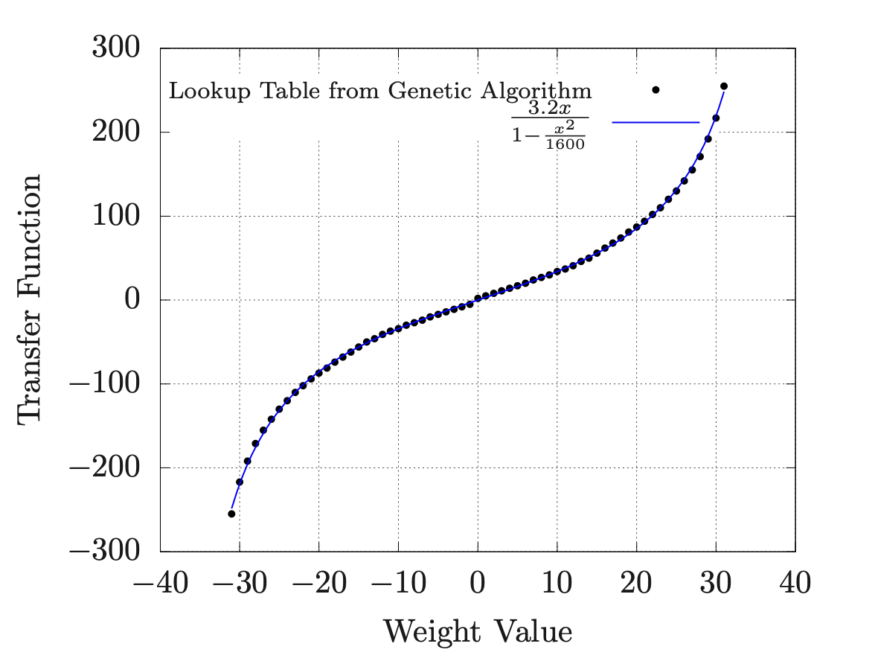
Non-linear transfer function
Maps weights from [-31,31] to [-255,255]
Implemented with lookup table
Found with genetic algorithm seeded with randomly chosen piecewise linear curves
Fits a “rational function” of 3.2x/(1-x²/1000)
Values slightly tweaked through exhaustive search near origin

Slide 18
Combining with TAGE-SC-L
Linear combination of MPP and SC confidences
Slope and bias statically tuned per combination of:
MPP prediction (2 possible values)
TAGE-SC-L prediction (2 values)
TAGE only prediction (2 values)
TAGE confidence (3 values)
24 sets of slopes and biases
Additional bias term dynamically trained to minimize the number of recent misses
Add the bias that would have resulted in the fewest number of mispredictions for recent predictions
64 possible biases tracked with 3 bit counters for each of the 24 combinations

Slide 19
Filtering always/never taken branches
24KB of 192KB budget devoted to 2 Bloom filters
Taken branches inserted into one filter. Not taken branches inserted into the other
Branches only update the MPP tables if they appear in both filters
But most branch histories continue to be updated for AT/NT
Otherwise, the prediction is based on the filter that has the branch, or a hacky static prediction if it’s an as-yet unseen branch
Filters are unrealistically wasteful of the H/W budget.
In a processor with an 8K-entry BTB, only 1KB of additional state would be needed to track AT/NT branches
MPP is more vulnerable to aliasing than TAGE due to updating all tables so filtering is necessary

Slide 20
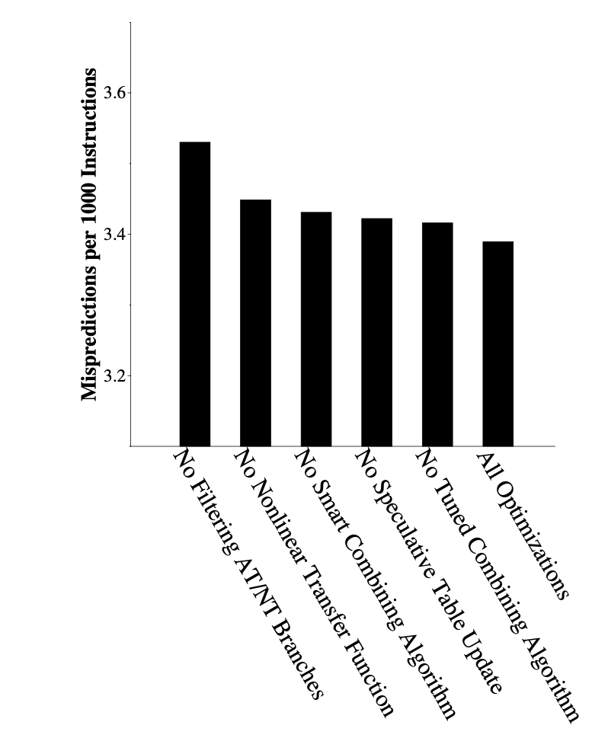
Value of optimizations
Graph shows MPKI when a given optimization is removed
Most valuable optimization is filtering AT/NT, +0.14 MPKI
Non-linear transfer function is also valuable, +0.06 MPKI
Dynamic bias tracking +0.042
Speculative table update, +0.033
Tuning slopes & biases, +0.026
(Average MPKI computed over organizers categories: compress, fp, infra, int, media, web)

Slide 21
MPKI and speedup results
Results over all 110 traces unweighted
(Organizers average by categories so final numbers slightly different)
I optimized for MPKI; optimizing for IPC probably a better idea
Speedups low. Not sure about their simulator
Idea | Avg MPKI | Geomean Speedup
Baseline 64KB TAGE-SC-L | 3.808 | 1.000
No AT/NT filtering | 3.576 | 1.012
No Smart Combining Algorithm | 3.564 | 1.010
192KB TAGE-SC-L | 3.516 | 1.015
No Transfer Function | 3.500 | 1.015
No Speculative Table Update | 3.482 | 1.015
No Tuned Combining Algorithm | 3.474 | 1.016
All Optimizations | 3.448 | 1.018
Weighted MPKI from CBP 2025 simulator (comparable to other papers): 3.3895

Slide 22
Hardware budget
64KB TAGE-SC-L
97.5KB weights tables
24KB Bloom filters
~5KB local history table
< 0.5KB other histories
< 0.5KB dynamic bias tracking tables
Other small counters and bits
Adds to 192KB

Slide 23
Implementation
This predictor is unrealistic because I’m going purely for accuracy
Ways to make it more realistic:
Limit number of tables; cuts down selection logic and adder tree
Replace taken/not-taken history with hash of bits from taken branch PCs/targets, so we can update history only on taken branches
Avoid sequential step of transfer function lookup table by applying function on update with wider weights
Think of less hacky more efficient bias tracking algorithm
Ahead-pipelining to mitigate latency of large table lookup and adder tree
Banking etc. tricks for multiple predictions per cycle
Local history is hard but it can be done; see the literature

Slide 24
Questions
Come see our ISCA paper on cache replacement in the session after lunch on Tuesday

