Slide 1
RUNLTS: Register-value-aware predictor Utilizing Nested Large TableS
Toru Koizumi¹, Toshiki Maekawa¹, Masanari Mizuno¹, Maru Kuroki², Tomoaki Tsumura¹, Ryota Shioya²
¹Nagoya Institute of Technology, ²The University of Tokyo

Slide 2
Introduction
The importance of branch prediction is ever increasing.
A wide frontend ($\sim$10-way fetch) and a large ROB ($\sim$1000 entries)
The branch predictor considered to be the most accurate: TAGE-SC(-L)^{[1]}
TAGE predicts based on the longest match of the global history
SC refines the TAGE prediction from multiple perspectives, including local histories
Proposed branch predictor: RUNLTS
Major contribution: Capturing correlations between register values and directions
Various improvements upon TAGE-SC
We reduced mispredictions by 6.2% compared with a 192KiB TAGE-SC-L baseline*.
[1] André Seznec. TAGE-SC-L Branch Predictors Again. In Proceedings of the 5th Championship Branch Prediction Workshop (CBP-5), 2016. *: Our tuning.

Slide 3
RUNLTS structure
High-level structure is almost the same as that of TAGE-SC.
We added register-value component to the SC.
Table predictor
Statistical corrector predictor (SC)
PC
PC GHR[5:0]
[13:0]
[4315:0]
PC, Table out, histories
h1
...
PC
h0
h1
hN
PC, register values
h2
h23
Bimodal
UT
WT0
WT1
...
Register-value component
Tagged table
Tagged table
...
Tagged table
WTN
...
...
Σ
Σ
...
Σ
...
Useful
x1 or xM
x
x
Use alt
alt
longest
Σ
Table out
SC out
Final Prediction

Slide 4
RUNLTS features
Register-value component [3.7%]
Table predictor improvements
Allocation throttling on TAGE [0.5%]
Novel history length selection [0.2%]
Statistical corrector predictor (SC) improvements
IMLI weighting [1.2%]
Call-stack history [0.4%]
FTL++-like threshold updating method [0.2%]
Some bias components tuning [0.2%]
[XX%] indicates the MPKI reduction
The sum of these reductions means the improvement of RUNLTS against iso-budget TAGE-SC-L.

Slide 5
Capturing register-value correlation
Motivation: Register values help in predicting hard-to-predict branches.
Challenges:
We need to identify correlated registers among the 65 registers.
The execution results of the last >100 instructions are not yet available at the branch prediction stage because of the pipeline depth and fetch width.
Existing approaches:
Instruction dependency graph reconstruction + ahead execution or value prediction
Our approach:
Use a perceptron to find correlated registers.
Focus on subsequent branch prediction after a branch misprediction has occurred.
The branch mispredictions will reveal execution results to the branch predictor.
They are useful for correcting subsequent burst branch misprediction.

Slide 6
Correlating register values with direction
Conventional SC component:
Multiple GEHL weight tables, indexed by PC⊕hash(hist[HL[i]:0])
A usefulness tracking table, indexed by PC
Weight multiplier
Useful: 2x / Not useful: 1x
Register value component:
Multiple weight tables, indexed by PC⊕hash(digest)
Using 12-bit register-value digest, instead of full 64-bit value
Per-reg skewed usefulness tracking tables, indexed by hash(PC)
Useful: 2.5x / Not useful: 0x
Silencing many non-correlated registers is important.
PC + history
PC
h0
h1
hN
UT
WT0
WT1
...
WTN
Σ
Useful
x1 or x2
PC (skewed)
UT0
UT1
UT2
PC + digest
Σ
h0
h1
h2
WT0
WT1
WT2
Σ
Useful
x0 or x2.5

Slide 7
Register-value digest
We use 12-bit register-value digest, instead of full 64-bit value.
It may improve generalization.
For integer registers, XOR the following:
Trailing ones/zeros
Leading ones/zeros
Least significant bits
→ Capture pointer/round number characteristics
For FP registers, use MSBs
Sign bit and higher part of exponent
→ Capture the magnitude
For flag register, replicate three times
→ Larger Hamming distance
(a) Integer registers
5
0
trailing one/zero #
8
3
leading one/zero #
11
6
Value[5:0]
(b) FP registers
FP16
Val[15:13]
FP32
Value[31:26]
FP64
Value[63:55]
(c) Flag register
Value[3:0]
Value[3:0]
Value[3:0]

Slide 8
Eliminating multi-ported RAM
Eight-bank structure + using only one of the 9 or 8 registers per bank
Each bank contains:
8-entry + 8-entry + 8-entry skewed 9-/8-register usefulness tables (UTs)
512-entry + 256-entry + 128-entry prediction weight tables (WTs)
At prediction: Select the most useful register from the available ones, based on the summed UT values.
At training: Select single register randomly and train for it. (next slide)
These eliminate multi-ported RAM.
8 regs digest
8 regs digest
PC (skewed)
9 regs digest
R0 R8 R16 ... R64
R1 R9
R7
...
...
bank 0
bank 1
bank 7
9x6bit
8 ent. UT0
8 ent.
UT1
8 ent.
UT2
PC + reg. digest
9 regs
useful (skewed)
Σ
h0
h1
h2
512 ent. WT0
256 ent.
WT1
128 ent.
WT2
...
largest
Most useful
in this bank.
Σ
x0 or x2.5
...
Σ
sum

Slide 9
Training register value component
For each of the eight banks, train UTs and WTs at every branch resolution (according to the perceptron updating rule^{[2]}).
If any register was used for the prediction, train for the register.
available and the most useful in the bank
If no register was used for the prediction, randomly select a register that was available at the prediction time, and then train for the register.
We can use the training port for exploration, eliminating multi-ported RAM.
Learning becomes slightly slower, but there is no significant accuracy loss.
[2] Daniel A. Jiménez and Calvin Lin. Dynamic branch prediction with perceptrons. In International Symposium on High Performance Computer Architecture (HPCA), pp. 197-206, 2001.

Slide 10
Tracking available registers
We use Tomasulo-like tabular method.
At decode stage
Invalidate the digest of destination register
Record a tag (ROB index)
(Invalidate too old digests [0.5%])
At execution stage
Record a digest if the tag matches
At prediction stage
Use only valid digests
R0
valid
tag or digest
R1
valid
tag or digest
R2
valid
tag or digest
R3
valid
tag or digest
$$⋮$$
$$⋮$$
R64
valid
tag or digest

Slide 11
Allocation throttling on TAGE
Motivation: How aggressively should we allocate tagged entries?
Too aggressive: causes thrashing ☹
Too conservative: slows training on new phases ☹
The idea of controlled allocation throttling (CAT) is introduced in 2018 by Michaud^{[3]}, but the application on TAGE is an open problem.
Our proposal: Storage-free allocation throttling on TAGE
Throttling based on the ratio of (1) eviction of newly allocated (NA) entry and (2) correct prediction from NA entry... How can this be done without storage?
[3] Pierre Michaud. An Alternative TAGE-like Conditional Branch Predictor. ACM Transactions on Architecture and Code Optimization, Vol. 15, No. 3, Article 30 (2018).

Slide 12
Storage-free allocation throttling on TAGE
Each TAGE entry contains
partial tag (~10 bits)
u-bit (1 bit, tracking usefulness)
saturating counter (3 bit, for prediction)
We found that specific combinations of {u, ctr} hardly appear.
→ We can safely use these combination for a marker of newly allocated entries.
Count following events and throttle allocation according to their ratio.
Eviction of marked entry
Correct prediction provided by marked entry
tag
u
ctr
 |  | ← weak prediction |  | strong prediction →
 |  | 0 or -1 | 1 or -2 | 2 or -3 | 3 or -4
not useful | 0 | 4.65% | 2.05% | 3.32% | 76.24%
useful | 1 | 0.02% | 0.99% | 0.98% | 11.75%

Slide 13
IMLI weighting
IMLI counter: inner most loop iteration counter^{[4]}
Recently, more robust counting methods were proposed: BrIMLI & TaIMLI^{[5]}.
We found that it provides a significant accuracy improvement when a loop contains hard-to-predict (H2P) branches.
→ When IMLI counter component is useful, there are also hard-to-predict branches.
for (i = 0; i < 999; ++i) {
if (!arr[i].valid) {
continue;
}
if (arr[i].data <= th) {
...
}
...
}
Predictable
Our improvements:
Large weight on useful (2x→3x); provide large weight, while
Enlarge per-PC usefulness table; keep small weight for H2Ps.
3x training on useful ; tolerate pollutions from H2Ps.
Large window (64B→128B) ; fit in the large loop.
Unpredictable
Typical example: repeated array traversal with changing only a few entries
IMLI-dir correlation can be captured.
History changes slightly each time; and thus history-dir correlation can hardly be captured.
[4] A. Seznec, J. S. Miguel and J. Albericio, The inner most loop iteration counter: A new dimension in branch history, In Annual IEEE/ACM International Symposium on Microarchitecture (MICRO), pp. 347-357 (2015). [5] TAGE: an engineering cookbook. HAL Inria, RR-9561 (2024). https://hal.science/hal-04804900

Slide 14
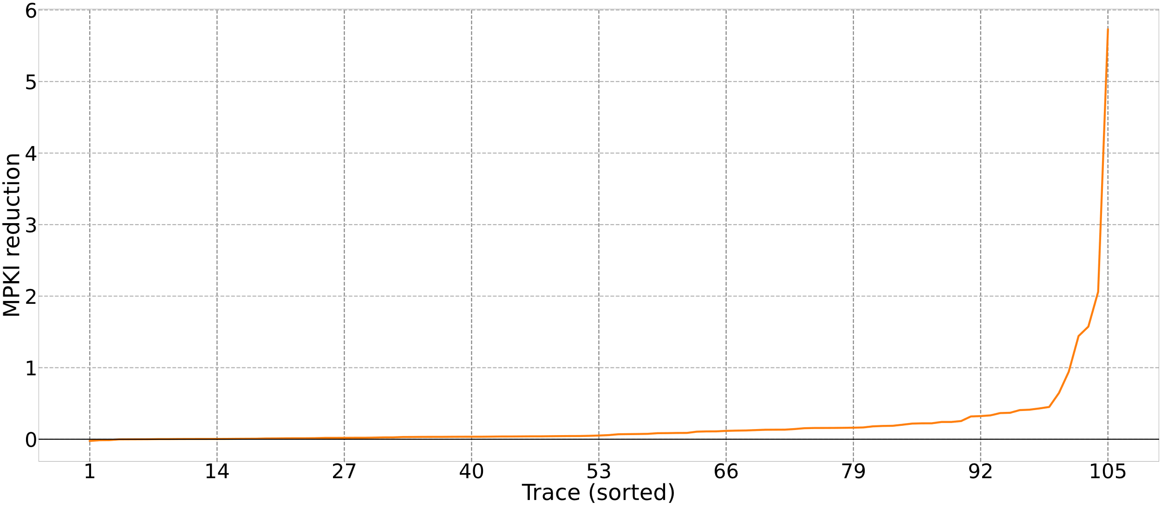
Evaluation: MPKI reduction (S-curve)
Compared to 192KiB TAGE-SC-L*, RUNLTS reduced branch mispredictions for almost all traces.
Higher is better.
*: Our tuning.

Slide 15
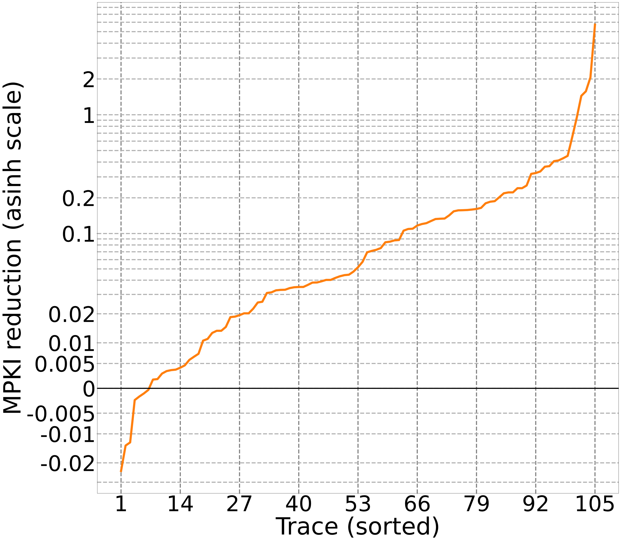
Evaluation: MPKI reduction (S-curve)
Average MPKI reduction: 0.211
First octile MPKI reduction: 0.323
Median MPKI reduction: 0.052
Worst MPKI reduction: -0.024
Best MPKI reduction: 5.727!!

Slide 16
RUNLTS feature contributions over TAGE-SC-L
Register value component improved wide-range of traces.
Dynamic allocation throttling improved large-footprint traces.
IMLI component largely improved three traces (int.1, int.2, and int.21).
～
～
～
～
～
～
～
～
～
～
compress
fp
infra
int
media
web

Slide 17
Conclusion
We proposed RUNLTS.
Major contribution: Capturing correlations between register values and directions
Various improvements upon TAGE-SC
RUNLTS reduced mispredictions by 6.2% compared to iso-budget TAGE-SC-L.
BATAGE(-SC)
TAGE-SC-L
Infrastructure development
RUNLTS
Git commit count (right axis)
Register component [3.7%]
Note: The vertical axis indicates mispredictions per kilo micro-ops. Sorry!

Slide 18
Novel history-length selection
We combined second-order arithmetic progression with conventional geometric progression.
Conventional geometric history lengths begin with 4, 5, 7, .... (for example), but the first few intervals are too narrow.
There should be a very small number of branches where the correlation cannot be captured at history length 4 and can be captured at history length 5.
Starting with second-order arithmetic progression is near-optimal.
History length | 0 |  | 6 |  | 14 |  | 24 |  | 36 |  | 50 |  | 66 |  | 84 |  | 104 |  | 126 |  | 150 |  | 178 |  | 212 |  | 252 |  | 300 |  | 358 |  | 426 |  | 506 |  | 602 |  | 776 |  | 1078 |  | 1606 |  | 2554 |  | 4316
First difference |  | +6 |  | +8 |  | +10 |  | +12 |  | +14 |  | +16 |  | +18 |  | +20 |  | +22 |  | +24 |  | ×1.19 |  | ×1.19 |  | ×1.19 |  | ×1.19 |  | ×1.19 |  | ×1.19 |  | ×1.19 |  | ×1.19 |  | ×1.29 |  | ×1.39 |  | ×1.49 |  | ×1.59 |  | ×1.69
Second difference |  |  | 2 |  | 2 |  | 2 |  | 2 |  | 2 |  | 2 |  | 2 |  | 2 |  | 2 |  |  |  |  |  |  |  |  |  |  |  |  |  |  |  |  |  | 0.1 |  | 0.1 |  | 0.1 |  | 0.1 |  | 0.1

Slide 20
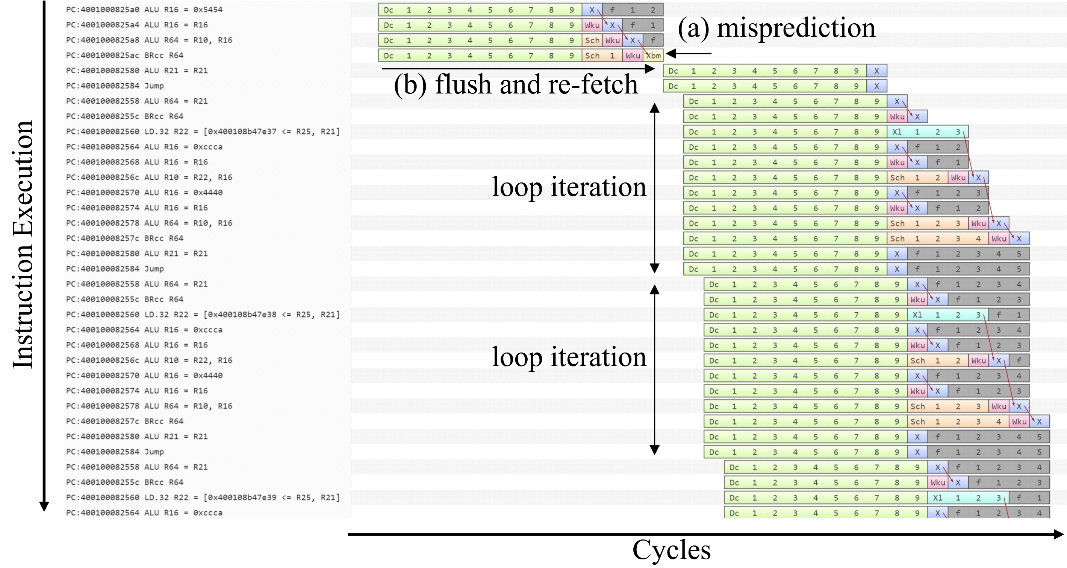

Slide 21
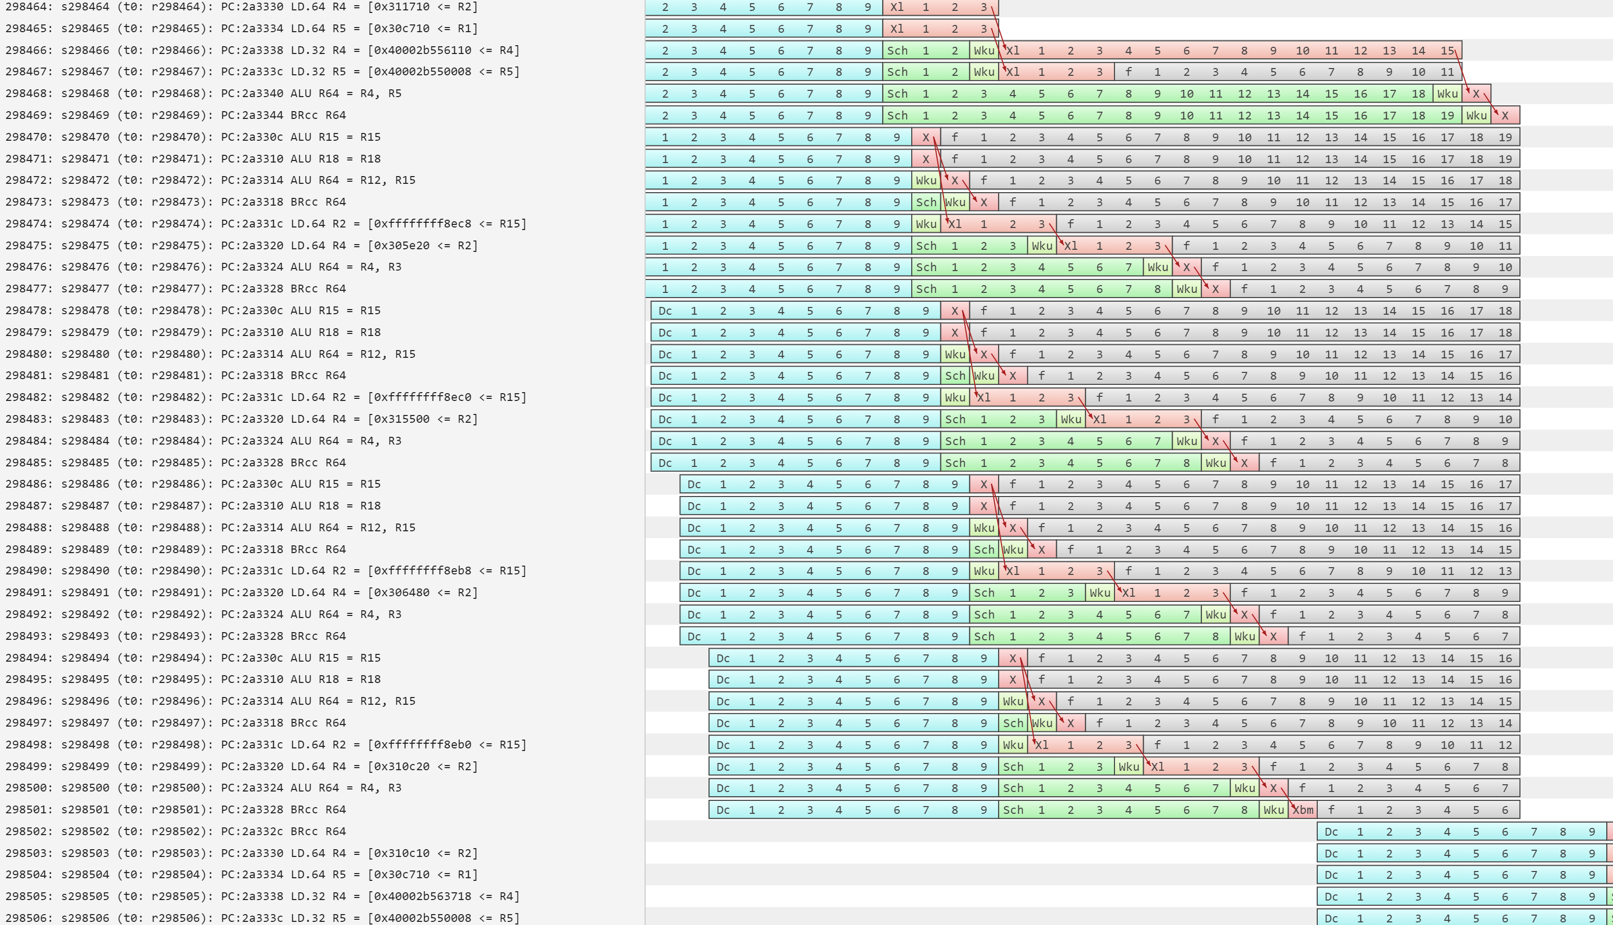

Slide 22
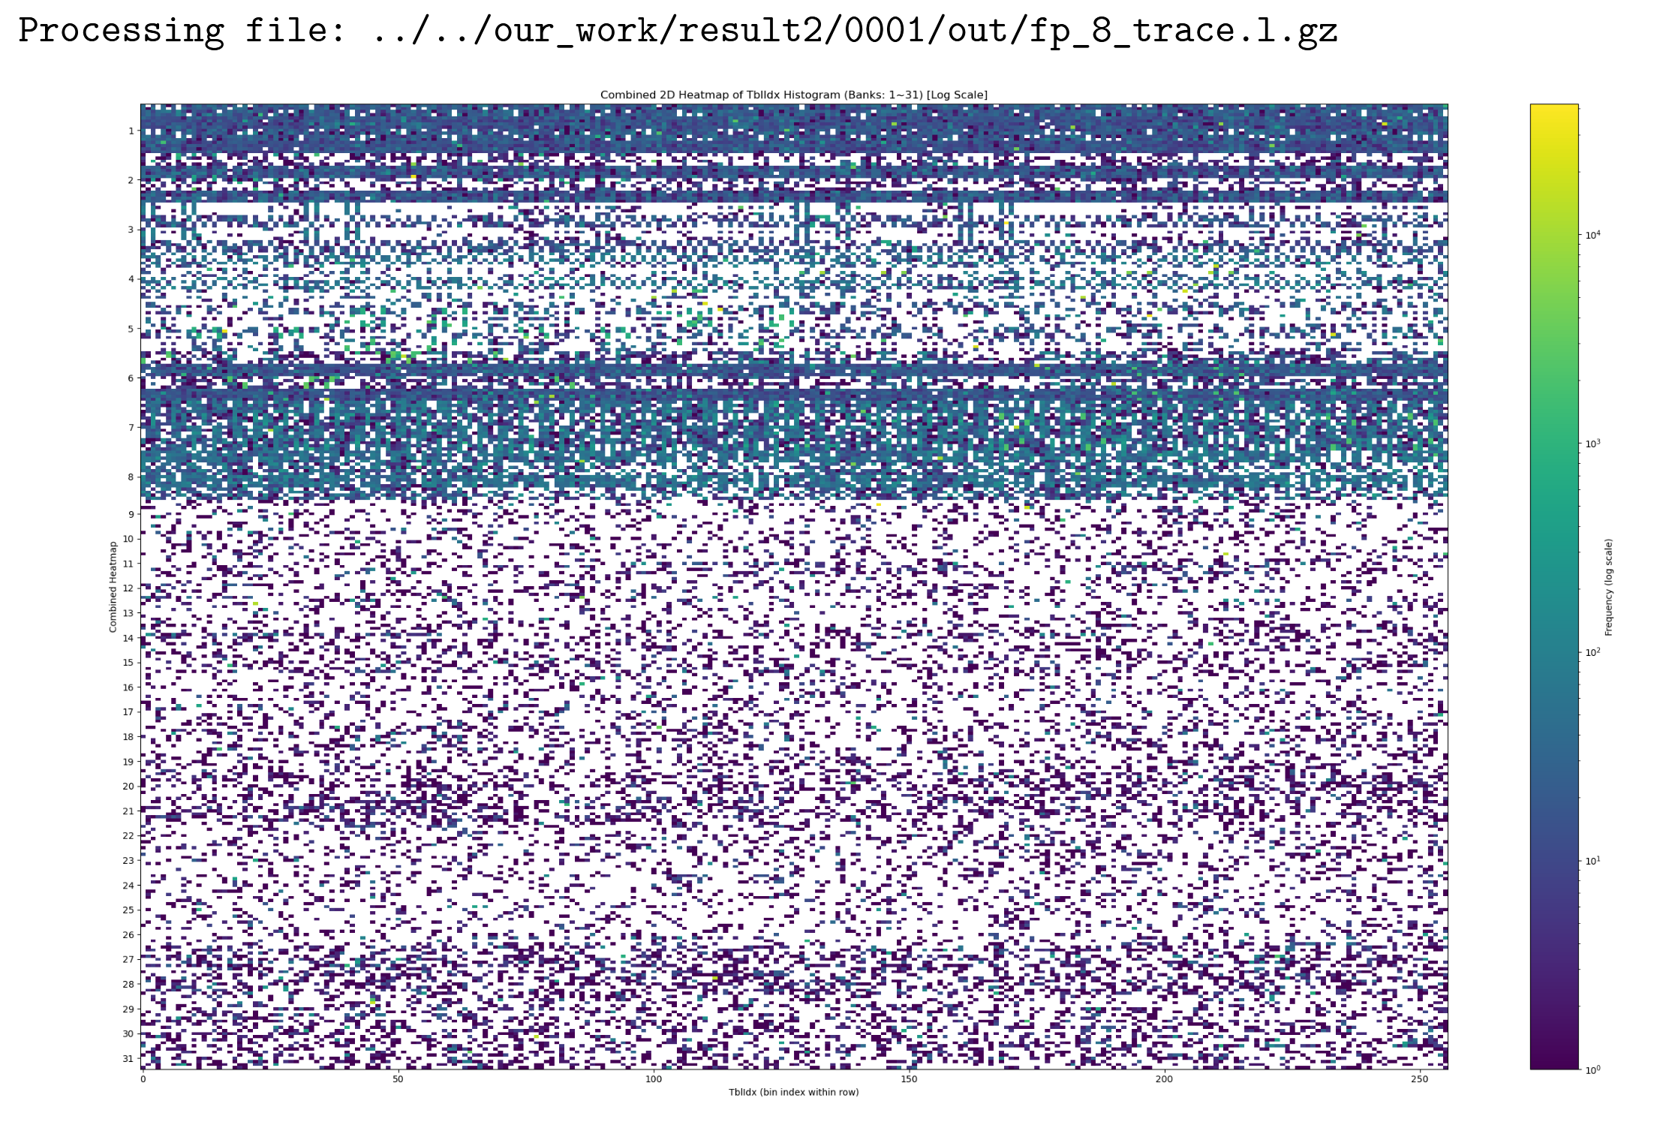

Slide 23
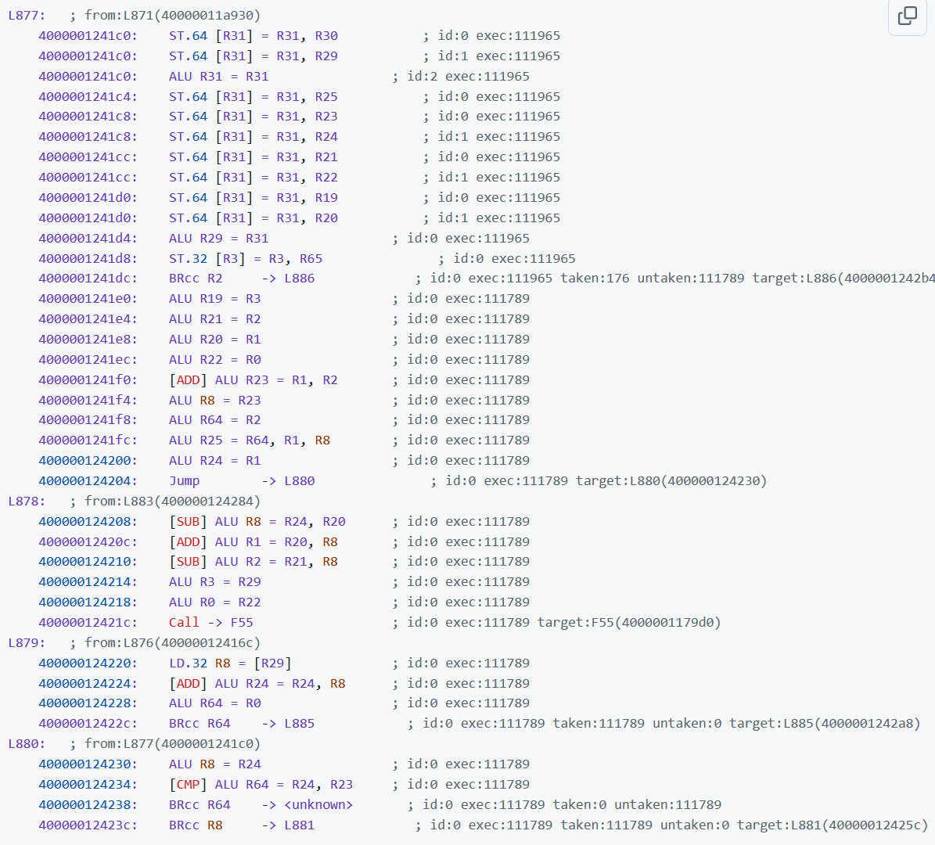

Slide 24
PC
PC GHR[5:0]
[13:0]
[23:0]
[35:0]
[49:0]
[4315:0]
h1
h2
h3
h4
h5
...
h23
128K-entry
Bimodal
20 KiB
Crossbar
Crossbar
...
...
... 9 banks
25 banks
...
...
Crossbar
Crossbar
...
High banks
19 components
Low banks
4 components
u
ctr
tag
...
2K entries
Use alt
alt
longest
Table out

Slide 25
(a) Bias Components
(b) History Components
PC
Table Out
Conf
HitBank
AltTaken
PC + histories
sG: global back + Table Out:
sP: forward taken path:
sC: call stack:
sI: Br+Ta IMLI:
sL: 256ent. local:
sS: 16ent. local:
sT: 16ent. local:
L=8,M=2,N=3
L=8,M=2,N=3
L=8,M=2,N=5
L=256,M=3,N=2(Br/Ta)
L=8,M=2,N=4
L=8,M=2,N=4
L=8,M=2,N=4
PC
h0
h1
hN
8 ent.
UT
Bias
BiasSK
BiasBank
L ent.
UT
WT0
WT1
...
WTN
Σ
Σ
Useful
x1 or x2
Useful
x1 or xM
sB
sG,sP,sC,sI,sL,sS,sT
(c) Proposed Register Components
(d) Decision
PC
9 regs digest
R0 R8 R16 ... R64
8 regs digest
8 regs digest
sB,sG,sP,sC,sI,sL,sS,sT,sR
...
...
...
bank 0
bank 1
bank 7
9x6bit
8 ent. UT0
8 ent.
UT1
8 ent.
UT2
Σ
PC + reg. digest
LSUM
9 regs
useful (skewed)
Σ
h0
h1
h2
...
 | Table High Conf | Table Mid Conf | Other
|LSUM|>Th/2 | SC (LSUM>=0) | SC | SC
|LSUM|>Th/4 | Meta1 | SC | SC
Other | Table Out | Meta2 | SC
largest
512 ent. WT0
256 ent.
WT1
128 ent.
WT2
Most useful
in this bank.
Σ
x0 or x2.5
...
Σ
sR

