Slide 1
Overcoming Hard-to-Predict Branches with the Bullseye Predictor
Emet Behrendt, Shing Wai Pun, Prashant Nair The University of British Columbia

Slide 2
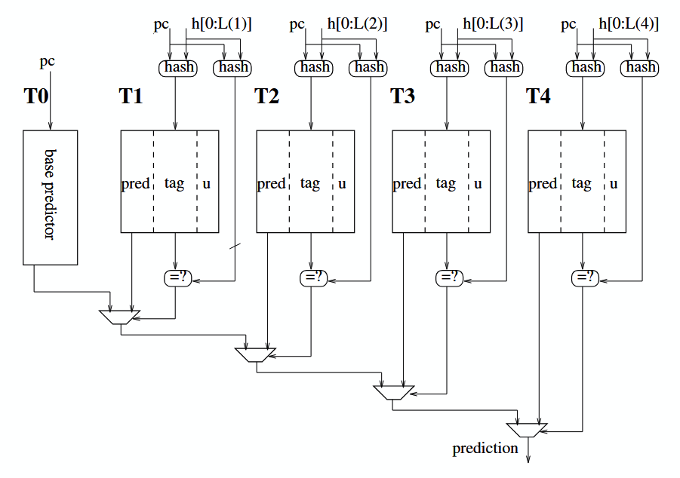
TAGE in the Present Day
Consistently a state-of-the-art predictor
Partially-tagged tables with varying history length
However, naively scaling table sizes provides diminishing returns on MPKI
64 kB TAGE-SC-L MPKI: 3.751
192 kB TAGE-SC-L MPKI: 3.428
Notes:
Picture Source: A case for (partially) TAgged GEometric history length branch predictor by Seznec and Michaud

Slide 3
TAGE in the Present Day
Recent improvements include:
Statistical Corrector
Loop Predictor
Most mispredictions caused by a few “hard-to-predict” branches - C.-K. Lin
Improvement should target these hard-to-predict branches
Notes:
Picture Source: A case for (partially) TAgged GEometric history length branch predictor by Seznec and Michaud

Slide 4
Hard-to-Predict (H2P) Branches
A branch with poor accuracy despite frequent executions
Causes include: data dependence, complex correlations patterns, and distance correlations
H2P branches have high history variation - observation by C.-K. Lin
TAGE’s usefulness counters only increment on correct predictions
H2P entries are quickly evicted Frequent re-allocations with low confidence

Slide 5
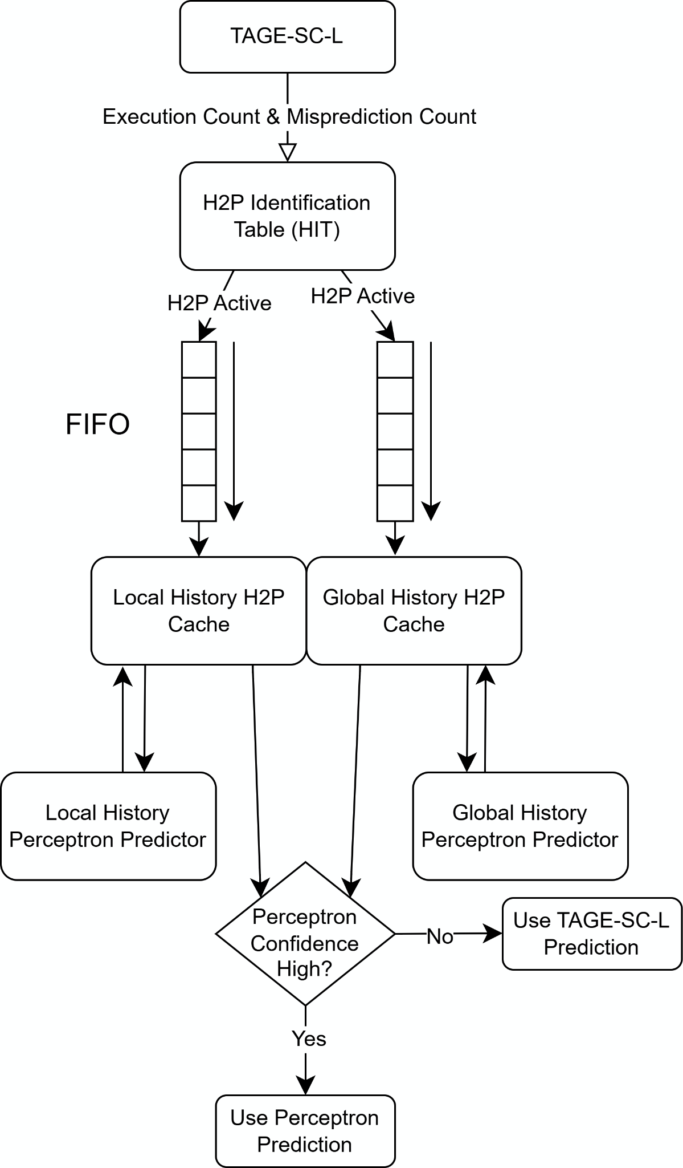
The Bullseye Predictor
Active H2P Identification and tracking
Solves H2P branches with:
Hashed local history perceptron
Folded global history perceptron
Notes:
Drive home the main point which is about enabling H2P detection, since perceptrons aren’t anything novel.
Many slides to step through and explain individual components of diagram
Talk about latency in design

Slide 6
H2P Identification Table (HIT)
Cache-like structure to identify and track potential H2P branches
Tracks:
Execution count
Misprediction rate
2-3 kB of memory
Updates on conditional branch resolve

Slide 7
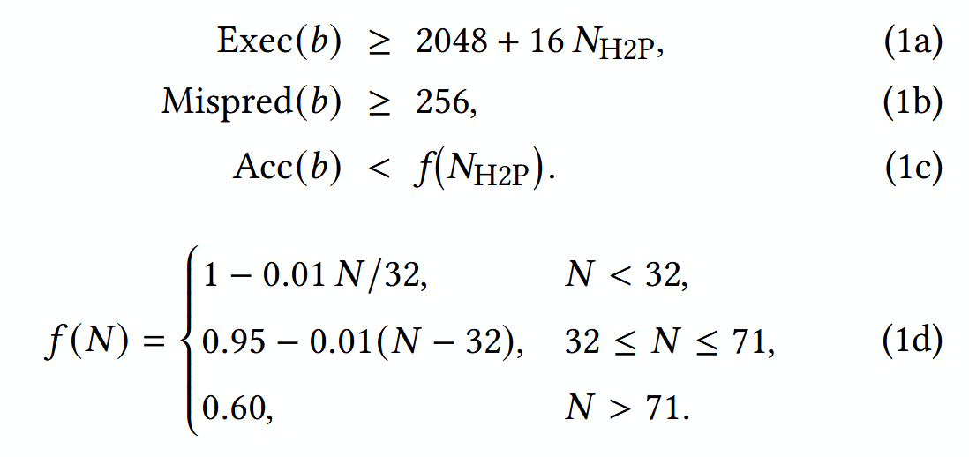
Identifying and Tracking H2Ps
Identify H2P branches using dynamically adjusted thresholds
Threshold values are varied depending on number of active H2P branches
Notes:
Important Note: Identified H2P branches are added to each FIFO and will be separately store in each cache. Caches are not identical due to differing evictions.

Slide 8
Perceptron Prediction
Perceptrons predict in parallel to TAGE-SC-L for H2P active branches
Working with a small set of branches allows for strong “targeted” predictor designs
Bullseye is not limited to perceptron-based predictors
Notes:
Point out that we have local and global history perceptron

Slide 9
Prediction Arbitration
TAGE-SC-L and perceptrons predict in parallel
Prediction chosen based on:
Confidence of TAGE-SC-L
Confidence of Perceptron
Historically better predictor for given branch

Slide 10
Performance Feedback
Newly identified H2Ps are given a “trial phase” where predictions are unused
Active H2P branches can be evicted if:
Poor performance relative to TAGE-SC-L
Branch is stale
TAGE-SC-L table updates are blocked when accuracy is poor relative to perceptron

Slide 11
Results

Slide 12
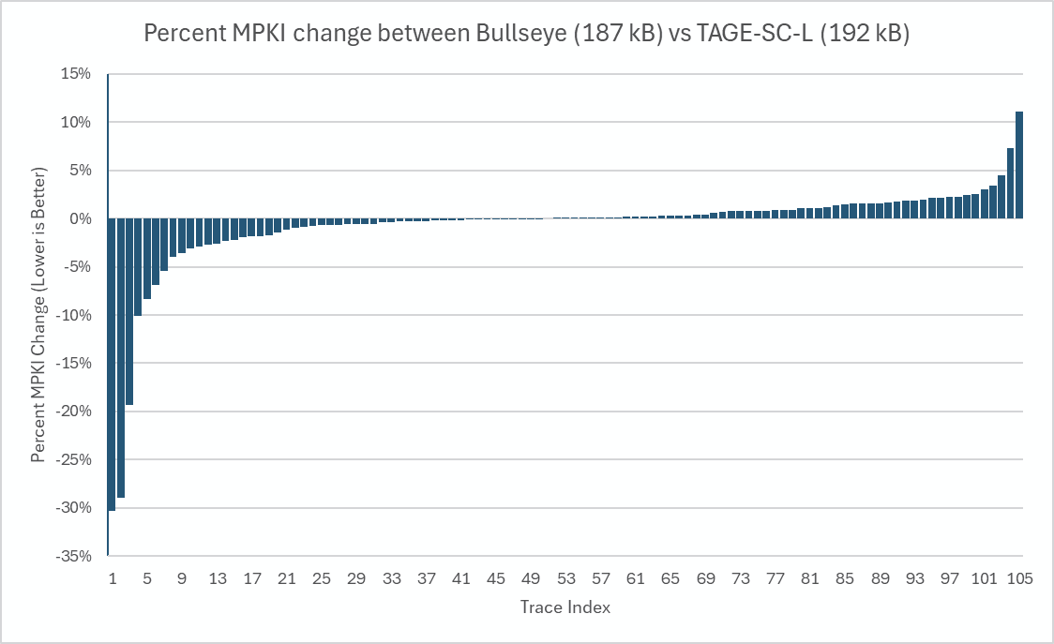
Notes:
Recall that lower MPKI is better

Slide 13
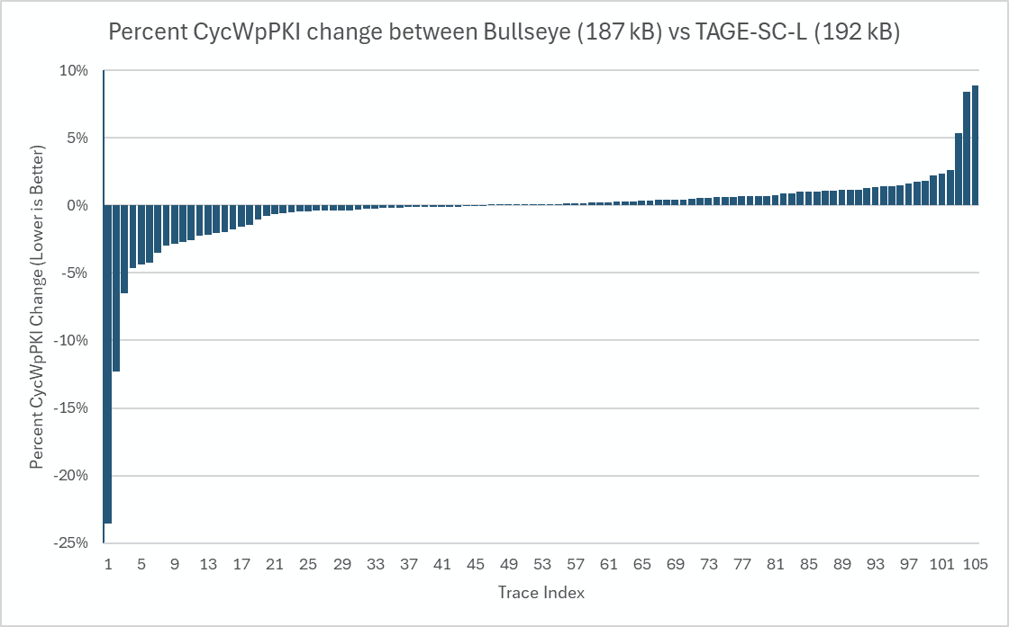
Notes:
Recall that lower Cycles Wasted is better

Slide 14
Discussion
H2P identification using HIT:
Very space efficient (2-3kB)
Does not affect branch prediction critical path
Bullseye provides a solution to scaling TAGE with an effective way to combine targeted predictors

Slide 15
Future Work
Use other targeted predictors with Bullseye H2P identification
Ex: a data dependent predictors
Test with different base predictors (modular)
Tune Bullseye hyperparameters

Slide 16
Questions?

Slide 18
Extra Slides (Not Presented)

Slide 19
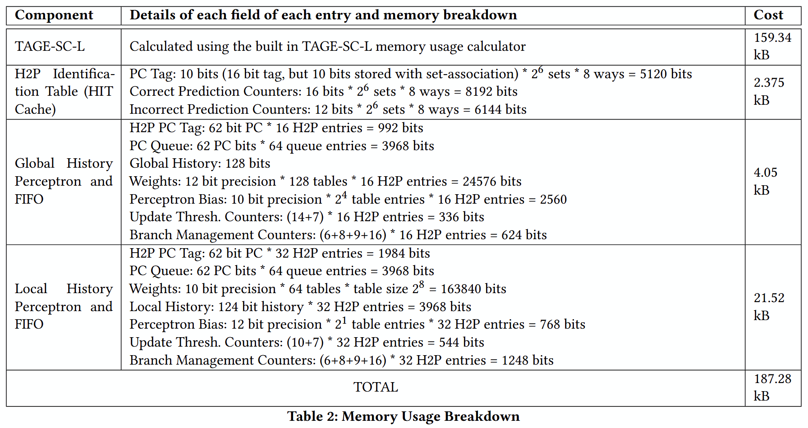
Notes:
Memory Breakdown

