Slide 1
TAGE-SC-L with a Code Structure Correlator
Chester Cai, Aniket Deshmukh, Evan Lai, Ali Mansoorshahi,
Mircea Tatulescu, Isaac Nudelman, Yale Patt
UT Austin
June 2025

Slide 2
Code Structure Correlator Motivation
Branch prediction remains a bottleneck in single-thread performance
TAGE-SC-L is state-of-the-art but still suffers from capacity issues
Easy-to-predict branches consume valuable storage

Slide 3
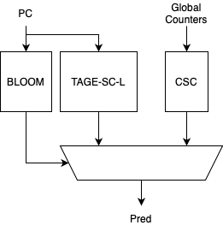
Prediction High-Level Overview
Hybrid predictor with TAGE-SC-L, CSC, and bloom filter
Parallel lookup of TAGE-SC-L and CSC
Bloom filter decides which prediction to use
TAGE-SC-L only updated after the first CSC mispredict

Slide 4
Code Structure Correlator (CSC)
Predicts based on common code structures that are shared across multiple PCs
Learnings from one PC can be applied to others
Motivated by code duplications, dynamic code relocation and JavaScript type check
Uses features like call depth, global bias, far/indirect branch counts.

Slide 5
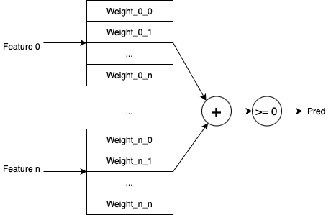
CSC Design
CSC is an O-GEHL like predictor
Feature -> Weight, prediction is the sum of the weights
Weights are updated by every branch, regardless of whether CSC prediction is used

Slide 6
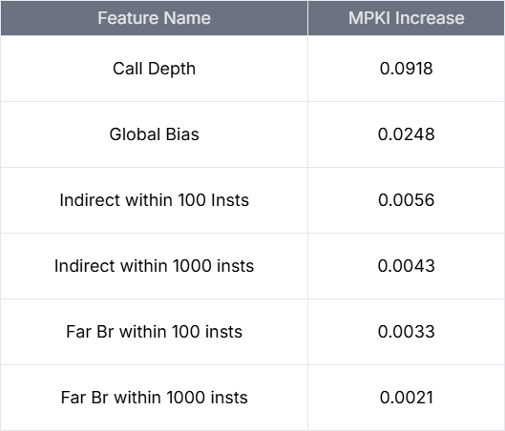
CSC Feature Sensitivity
Ablation study highlights importance of each feature
Call Depth is most impactful by far
Features besides Call Depth, Global Bias, have noise level impact on MPKI

Slide 7
Bloom Filter Selector
All branches are initially predicted by the CSC (bloom filter starts empty)
Once a PC mispredicts once from the CSC, it is added to the bloom filter and TAGE-SC-L then trains on it
This branch will be predicted by TAGE-SC-L moving forward
Implemented with a bloom filter, but can be potentially incorporated in the BTB

Slide 8
Why is CSC not part of SC?
All components in SC are PC based and can interfere/outweigh with the components in CSC
The selection logic between SC and TAGE uses the final sum and TAGE confidence
SC is built in mind that TAGE will always be trained alongside, therefore TAGE's confidence is meaningful in this case
Using TAGE's confidence when TAGE is untrained for this branch does not make sense

Slide 9
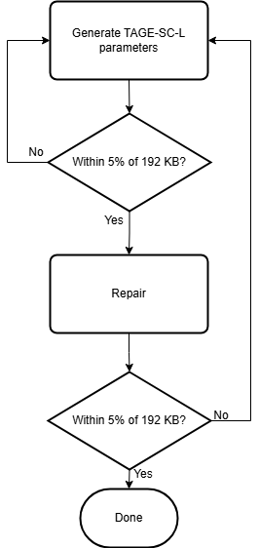
Fuzzing CSC-TAGE-SC-L Parameters
Fuzzing with evolutionary style DEAP framework
Flowchart shows generation of one individual
Fitness is average MPKI, best individual of each generation is kept

Slide 10
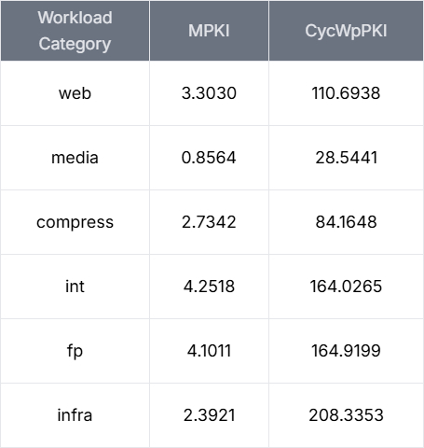
Experimental Results
CSC-TAGE-SC-L has an average mean of 3.46 MPKI
7.73% lower than the baseline 2016 TAGE-SC-L

Slide 11
Conclusion
CSC complements TAGE-SC-L by offloading simple branches
CSC offers a cheaper solution (1.69 KB) for branches that are easy to predict
More features could be explored
Different training strategy
Alternatives to bloom filter could be explored

Slide 12
Q&A
Thank you! Questions?

Slide 13
Backup Slides

Slide 14
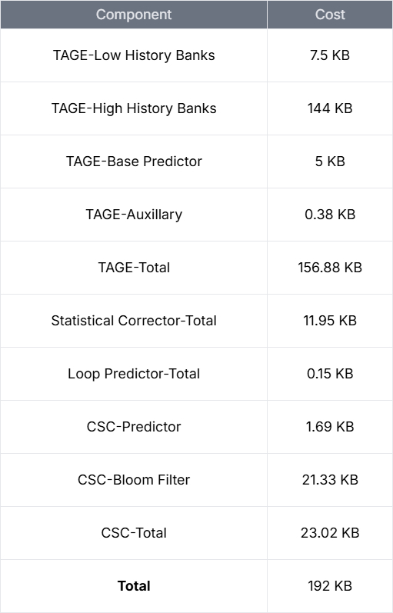
Predictor Storage Breakdown
TAGE high history banks dominate storage
CSC is 23.02 KB (~12% of whole predictor), due to the 21.33 KB bloom filter
Actual CSC predictor takes up 1.69 KB, only 0.88% of total storage budget

